Slide 1
The Proverbial Log Jam Recognizing and Repenting of Sin
2014 Durango Church Meeting
J. Zachary Huff
sakodemayo@hotmail.com
817-583-1090
July 2014

Slide 2
Ministering the Body of Christ
Review from this Week
1 Cor. 12 → one body, many members
Titus 2:4 → Older women to teach the younger
1 Tim 4:2 → Let no man despise thy youth
2 Tim 3:16 → Word is for teaching, reproof, correction, training

Slide 3
We All have Roles that Lead to Growth and Fruitfulness
Proverbs 27:17
17 Iron sharpens iron, and one man sharpens another.
Hebrews 3:13
13 But exhort one another daily, while it is called To day; lest any of you be hardened through the deceitfulness of sin.
Matthew 13:22
22 As for what was sown among thorns, this is the one who hears the word, but the cares of the world and the deceitfulness of riches choke the word, and it proves unfruitful.
Galatians 5:9
9 A little leaven leavens the whole lump.

Slide 4
1st Two Kings of Israel Fell To Sin
1st King - Saul
Chosen by God
Great Man & Leader
Fell to Sin
2nd King - David
Chosen by God
Great Man & Leader
Fell to Sin
How Bad was Their Sin and How did it Affect Them?

Slide 5
The 1st King, Saul
What was His Sin and how Bad was it?
1 Samuel 15:1-5
1 Then Samuel said to Saul, “The Lord sent me to anoint you as king over His people, over Israel; now therefore, listen to the words of the Lord. 2 “Thus says the Lord of hosts, ‘I will punish Amalek for what he did to Israel, how he set himself against him on the way while he was coming up from Egypt. 3 ‘Now go and strike Amalek and utterly destroy all that he has, and do not spare him; but put to death both man and woman, child and infant, ox and sheep, camel and donkey.’ ” 4 Then Saul summoned the people and numbered them in Telaim, 200,000 foot soldiers and 10,000 men of Judah. 5 Saul came to the city of Amalek and set an ambush in the valley…

Slide 6
The 1st King, Saul
What was His Sin and how Bad was it?
1 Samuel 15:6-9
6 Saul said to the Kenites, “Go, depart, go down from among the Amalekites, so that I do not destroy you with them; for you showed kindness to all the sons of Israel when they came up from Egypt.” So the Kenites departed from among the Amalekites. 7 So Saul defeated the Amalekites, from Havilah as you go to Shur, which is east of Egypt. 8 He captured Agag the king of the Amalekites alive, and utterly destroyed all the people with the edge of the sword. 9 But Saul and the people spared Agag and the best of the sheep, the oxen, the fatlings, the lambs, and all that was good, and were not willing to destroy them utterly; but everything despised and worthless, that they utterly destroyed.

Slide 7
What is the Sin and how Bad is it?
King Saul
King David
(2 Sam. 11)
Did not utterly destroy everything

Slide 8
What is the Sin and how Bad is it?
King Saul
Who’s Sin Was Worse?
Who’s Sin Had The Worse Consequences?
King David
(2 Sam. 11)
Did not utterly destroy everything
David lusted in his heart
David committed adultery
David tried to hide his sin
David plotted Uriah’s murder
David commanded the army to forsake their faithful comrade
David sacrificed others for his plot
David used his power for selfish gain

Slide 9
What was the Final Outcome of Saul’s Sin?
1 Samuel 15:10-11
10 Then the word of the Lord came to Samuel, saying, 11 “I regret that I have made Saul king, for he has turned back from following Me and has not carried out My commands.” And Samuel was distressed and cried out to the Lord all night.
1 Samuel 15:23
23 “For rebellion is as the sin of divination, And insubordination is as iniquity and idolatry. Because you have rejected the word of the Lord, He has also rejected you from being king.”

Slide 10
What was the Final Outcome of Saul’s Sin?
1 Samuel 15:34-35
34 Then Samuel went to Ramah, but Saul went up to his house at Gibeah of Saul. 35 Samuel did not see Saul again until the day of his death; for Samuel grieved over Saul. And the Lord regretted that He had made Saul king over Israel.
1 Samuel 22:18–19
18 Then the king said to Doeg, “You turn and strike the priests.” And Doeg the Edomite turned and struck down the priests, and he killed on that day eighty-five persons who wore the linen ephod. 19 And Nob, the city of the priests, he put to the sword; both man and woman, child and infant, ox, donkey and sheep, he put to the sword.

Slide 11
Final Outcome
Saul | David
The Lord rejected Saul The Lord regretted making Saul king Saul slaughtered God’s priest and the city of Nob (1 Sam 22)

Slide 12
What was the Final Outcome of David’s Sin?
2 Chronicles 7:17–18
17 And as for you, if you will walk before me as David your father walked, doing according to all that I have commanded you and keeping my statutes and my rules, 18 then I will establish your royal throne, as I covenanted with David your father, saying, ‘You shall not lack a man to rule Israel.’
Acts 13:22–23
22 And when he had removed him, he raised up David to be their king, of whom he testified and said, ‘I have found in David the son of Jesse a man after my heart, who will do all my will.’
Luke 18:35–38
35 As he drew near to Jericho, a blind man was sitting by the roadside begging. 36 And hearing a crowd going by, he inquired what this meant. 37 They told him, “Jesus of Nazareth is passing by.” 38 And he cried out, “Jesus, Son of David, have mercy on me!”

Slide 13
Final Outcome
Saul | David
The Lord rejected Saul The Lord regretted making Saul king Saul slaughtered God’s priest and the city of Nob (1 Sam 22) | God took away David’s sin Israel’s greatest king Became a benchmark for good Israel prospered A man after God’s own heart Jesus called the son of David

Slide 14
Why the Difference?
Let’s Look at Saul’s Initial Response to Sin
1 Samuel 15:1-15
13 Samuel came to Saul, and Saul said to him, “Blessed are you of the Lord! I have carried out the command of the Lord.” 14 But Samuel said, “What then is this bleating of the sheep in my ears, and the lowing of the oxen which I hear?” 15 Saul said, “They have brought them from the Amalekites, for the people spared the best of the sheep and oxen, to sacrifice to the Lord your God; but the rest we have utterly destroyed.”

Slide 15
Why the Difference?
Saul’s Initial Response to Sin
1 Samuel 15:18-21
18 and the Lord sent you on a mission, and said, ‘Go and utterly destroy the sinners, the Amalekites, and fight against them until they are exterminated.’ 19 “Why then did you not obey the voice of the Lord, but rushed upon the spoil and did what was evil in the sight of the Lord?” 20 Then Saul said to Samuel, “I did obey the voice of the Lord, and went on the mission on which the Lord sent me, and have brought back Agag the king of Amalek, and have utterly destroyed the Amalekites. 21 “But the people took some of the spoil, sheep and oxen, the choicest of the things devoted to destruction, to sacrifice to the Lord your God at Gilgal.”

Slide 16
Initial Response to Sin
Saul | David
I have obeyed the Lord Denial What we did was for good Justification I did obey and we did good Denial and justification

Slide 17
Why the Difference?
David’s Initial Response to Sin
2 Samuel 12:1–7
1 Then the Lord sent Nathan to David. And he came to him and said, “There were two men in one city, the one rich and the other poor. 2 “The rich man had a great many flocks and herds. 3 “But the poor man had nothing except one little ewe lamb Which he bought and nourished; And it grew up together with him and his children. It would eat of his bread and drink of his cup and lie in his bosom, And was like a daughter to him. 4 “Now a traveler came to the rich man, And he was unwilling to take from his own flock or his own herd, To prepare for the wayfarer who had come to him; Rather he took the poor man’s ewe lamb and prepared it for the man who had come to him.” 5 Then David’s anger burned greatly against the man, and he said to Nathan, “As the Lord lives, surely the man who has done this deserves to die. 6 “He must make restitution for the lamb fourfold, because he did this thing and had no compassion.” 7 Nathan then said to David, “You are the man! Thus says the Lord God of Israel, ‘It is I who anointed you king over Israel and it is I who delivered you from the hand of Saul.

Slide 18
Why the Difference?
David’s Initial Response to Sin
2 Samuel 12:1–13
8 ‘I also gave you your master’s house and your master’s wives into your care, and I gave you the house of Israel and Judah; and if that had been too little, I would have added to you many more things like these! 9 ‘Why have you despised the word of the Lord by doing evil in His sight? You have struck down Uriah the Hittite with the sword, have taken his wife to be your wife, and have killed him with the sword of the sons of Ammon. 10 ‘Now therefore, the sword shall never depart from your house, because you have despised Me and have taken the wife of Uriah the Hittite to be your wife.’ 11 “Thus says the Lord, ‘Behold, I will raise up evil against you from your own household; I will even take your wives before your eyes and give them to your companion, and he will lie with your wives in broad daylight. 12 ‘Indeed you did it secretly, but I will do this thing before all Israel, and under the sun.’ ” 13 Then David said to Nathan, “I have sinned against the Lord.” And Nathan said to David, “The Lord also has taken away your sin; you shall not die.

Slide 19
Initial Response to Sin
Saul | David
I have obeyed the Lord Denial What we did was for good Justification I did obey and we did good Denial and justification | I have sinned against the Lord

Slide 20
Saul’s 2nd Response to Sin
1 Samuel 15:23-25
23 “For rebellion is as the sin of divination, And insubordination is as iniquity and idolatry. Because you have rejected the word of the Lord, He has also rejected you from being king.” 24 Then Saul said to Samuel, “I have sinned; I have indeed transgressed the command of the Lord and your words, because I feared the people and listened to their voice. 25 “Now therefore, please pardon my sin and return with me, that I may worship the Lord.”

Slide 21
Saul’s 2nd Response to Sin
1 Samuel 15:26-30
26 But Samuel said to Saul, “I will not return with you; for you have rejected the word of the Lord, and the Lord has rejected you from being king over Israel.” 27 As Samuel turned to go, Saul seized the edge of his robe, and it tore. 28 So Samuel said to him, “The Lord has torn the kingdom of Israel from you today and has given it to your neighbor, who is better than you. 29 “Also the Glory of Israel will not lie or change His mind; for He is not a man that He should change His mind.” 30 Then he said, “I have sinned; but please honor me now before the elders of my people and before Israel, and go back with me, that I may worship the Lord your God.”

Slide 22
2nd Response to Sin
Saul | David
I have sinned But because of others Pardon my sin and honor me * Didn’t want the consequence of sin

Slide 23
David’s 2nd Response to Sin
Psalm 51:1-9
1 Be gracious to me, O God, according to Your loving kindness; According to the greatness of Your compassion blot out my transgressions. 2 Wash me thoroughly from my iniquity And cleanse me from my sin. 3 For I know my transgressions, And my sin is ever before me. 4 Against You, You only, I have sinned And done what is evil in Your sight, So that You are justified when You speak And blameless when You judge. 5 Behold, I was brought forth in iniquity, And in sin my mother conceived me. 6 Behold, You desire truth in the innermost being, And in the hidden part You will make me know wisdom. 7 Purify me with hyssop, and I shall be clean; Wash me, and I shall be whiter than snow. 8 Make me to hear joy and gladness, Let the bones which You have broken rejoice. 9 Hide Your face from my sins And blot out all my iniquities.

Slide 24
David’s 2nd Response to Sin
Psalm 51:10-19
10 Create in me a clean heart, O God, And renew a steadfast spirit within me. 11 Do not cast me away from Your presence And do not take Your Holy Spirit from me. 12 Restore to me the joy of Your salvation And sustain me with a willing spirit. 13 Then I will teach transgressors Your ways, And sinners will be converted to You. 14 Deliver me from blood guiltiness, O God, the God of my salvation; Then my tongue will joyfully sing of Your righteousness. 15 O Lord, open my lips, That my mouth may declare Your praise. 16 For You do not delight in sacrifice, otherwise I would give it; You are not pleased with burnt offering. 17 The sacrifices of God are a broken spirit; A broken and a contrite heart, O God, You will not despise. 18 By Your favor do good to Zion; Build the walls of Jerusalem. 19 Then You will delight in righteous sacrifices, In burnt offering and whole burnt offering; Then young bulls will be offered on Your altar.

Slide 25
2nd Response to Sin
Saul | David
I have sinned But because of others Pardon my sin and honor me * Didn’t want the consequence of sin | My sin is ever before me Blot out my iniquities Create in me a clean heart Renew a steadfast spirit I have nothing to offer Do good to Zion * Didn’t want to be sinful

Slide 26
Summary of How the Two Kings Handled Sin
Saul
David
He would not recognize it
He denied it
He justified it
He blamed it on others
He only asked for forgiveness to avoid sin’s consequences
He never showed concern for the state of his heart or soul
He recognized it
He was sincerely sorry and hurt by it
He admitted and confessed it
He repented of it
He asked forgiveness for it
He asked for God to give him a pure heart and spirit

Slide 27
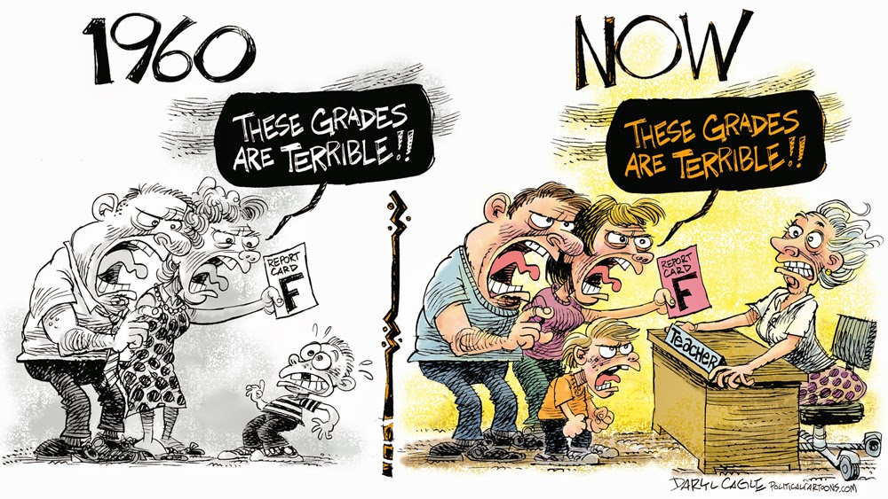
Are We Like Saul?
Do We Train Our Children To Be Like Saul?
David

Slide 28
A New Testament Saul and David
Luke 18:10–14
10 “Two men went up into the temple to pray, one a Pharisee and the other a tax collector. 11 The Pharisee, standing by himself, prayed thus: ‘God, I thank you that I am not like other men, extortioners, unjust, adulterers, or even like this tax collector. 12 I fast twice a week; I give tithes of all that I get.’ 13 But the tax collector, standing far off, would not even lift up his eyes to heaven, but beat his breast, saying, ‘God, be merciful to me, a sinner!’ 14 I tell you, this man went down to his house justified, rather than the other. For everyone who exalts himself will be humbled, but the one who humbles himself will be exalted.”

Slide 29
The Proverbial Log Jam
Matthew 7:1–5
1 “Do not judge so that you will not be judged. 2 “For in the way you judge, you will be judged; and by your standard of measure, it will be measured to you. 3 “Why do you look at the speck that is in your brother’s eye, but do not notice the log that is in your own eye? 4 “Or how can you say to your brother, ‘Let me take the speck out of your eye,’ and behold, the log is in your own eye? 5 “You hypocrite, first take the log out of your own eye, and then you will see clearly to take the speck out of your brother’s eye.

Slide 30
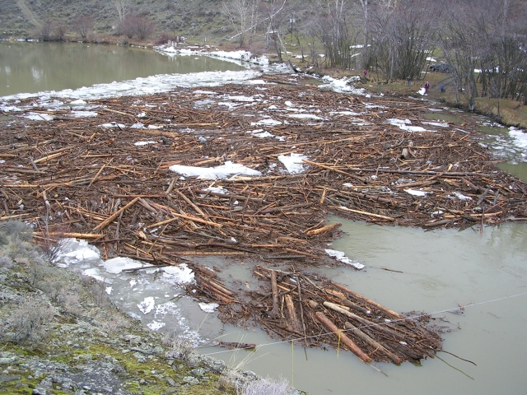
The Proverbial Log Jam

Slide 31
Two Mistakes Dealing With The Log Jam
I must be perfect before I can function as a member of the body
Now I’m perfect and can function as a member of the body
1 John 1:8–10
8 If we say that we have no sin, we are deceiving ourselves and the truth is not in us. 9 If we confess our sins, He is faithful and righteous to forgive us our sins and to cleanse us from all unrighteousness. 10 If we say that we have not sinned, we make Him a liar and His word is not in us.
Romans 7:24
24 Wretched man that I am! Who will set me free from the body of this death?

Slide 32
Saul’s Repentance
Saul eventually admitted his sin and asked to be pardoned…
But he wasn’t pardoned.
2 Tim 2:24-26
The Lord's bond-servant must not be quarrelsome, but be kind to all, able to teach, patient when wronged, 25 with gentleness correcting those who are in opposition, if perhaps God may grant them repentance leading to the knowledge of the truth, 26 and they may come to their senses and escape from the snare of the devil, having been held captive by him to do his will.

Slide 33
The Opportunity to Repent Comes From God
Revelation 2:20–22
20 ‘But I have this against you, that you tolerate the woman Jezebel, who calls herself a prophetess, and she teaches and leads My bond-servants astray so that they commit acts of immorality and eat things sacrificed to idols. 21 ‘I gave her time to repent, and she does not want to repent of her immorality. 22 ‘Behold, I will throw her on a bed of sickness, and those who commit adultery with her into great tribulation, unless they repent of her deeds.
Acts 11:16-18
16 "And I remembered the word of the Lord, how He used to say, ' John baptized with water, but you will be baptized with the Holy Spirit.' 17 "Therefore if God gave to them the same gift as He gave to us also after believing in the Lord Jesus Christ, who was I that I could stand in God's way?" 18 When they heard this, they quieted down and glorified God, saying, "Well then, God has granted to the Gentiles also the repentance that leads to life."

Slide 34
The Good News
2 Peter 3:9
9 The Lord is not slow about His promise, as some count slowness, but is patient toward you, not wishing for any to perish but for all to come to repentance.

Slide 35
There Is Only One Way To Overcome Sin
Romans 6:1–11
1 What shall we say then? Are we to continue in sin so that grace may increase? 2 May it never be! How shall we who died to sin still live in it? 3 Or do you not know that all of us who have been baptized into Christ Jesus have been baptized into His death? 4 Therefore we have been buried with Him through baptism into death, so that as Christ was raised from the dead through the glory of the Father, so we too might walk in newness of life. 5 For if we have become united with Him in the likeness of His death, certainly we shall also be in the likeness of His resurrection, 6 knowing this, that our old self was crucified with Him, in order that our body of sin might be done away with, so that we would no longer be slaves to sin; 7 for he who has died is freed from sin. 8 Now if we have died with Christ, we believe that we shall also live with Him, 9 knowing that Christ, having been raised from the dead, is never to die again; death no longer is master over Him. 10 For the death that He died, He died to sin once for all; but the life that He lives, He lives to God. 11 Even so consider yourselves to be dead to sin, but alive to God in Christ Jesus.

