Slide 1
HONOR! WHAT IS IT?
1 Timothy 5:8

Slide 2
1 TIMOTHY 5:8
1 Tim 5:8
But if any provide not for his own, and specially for those of his own house, he hath denied the faith, and is worse than an infidel.
KJV

Slide 3
HONOR DEFINED
ACCORDING TO JESUS, HONOR INVOLVES ACTION

Slide 4
Matt 15:8-9
This people draweth nigh unto me with their mouth, and honoureth me with their lips; but their heart is far from me.

Slide 5
EXAMPLES
JESUS PROVIDES FOR THE MULTITUDE
MAT. 14:19-21
JESUS PROVIDES FOR HIS MOTHER
JOHN 19:27
RUTH HONORS HER MOTHER-IN-LAW

Slide 6
Ruth 1:15
And Ruth said, Intreat me not to leave thee, or to return from following after thee: for whither thou goest, I will go; and where thou lodgest, I will lodge: thy people shall be my people, and thy God my God:
KJV

Slide 7
1 Tim 5:3
Honour widows that are widows indeed
KJV

Slide 8
Ruth 2:2
And Ruth the Moabitess said unto Naomi, Let me now go to the field, and glean ears of grain after him in whose sight I shall find grace. And she said unto her, Go, my daughter
KJV

Slide 9
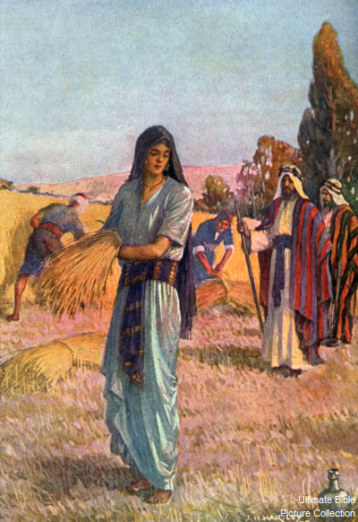

Slide 10
Ruth 2:17
So she gleaned in the field until evening, and beat out that which she had gleaned: and it was about an ephah of barley.

Slide 11
Ruth was a honorable woman
Ruth 2:11
And Boaz answered and said to her, It hath fully been shown to me, all that thou hast done to thy mother-in-law since the death of thy husband: and how thou hast left thy father and thy mother, and the land of thy nativity, and hast come to a people which thou knewest not heretofore.

Slide 12
APPLICATION
1 Tim 5:8
But if any provide not for his own, and specially for those of his own house, he hath denied the faith, and is worse than an infidel.
KJV

Slide 13
James 2:15-16
If a brother or sister be naked, and destitute of daily food,
16 And one of you say unto them, Depart in peace, be ye warmed and filled; notwithstanding ye give them not those things which are needful to the body; what doth it profit?
KJV

